Slide 1


Implications of Autonomous Vehicles for Accessibility and Transport-related Social Exclusion
Thesis Proposal Defence
Candidate: Arkar Than Win
Supervisors: Professor John Nelson and Associate Professor Chinh Ho
Discipline: Institute of Transport and Logistics Studies
Date: 4th of June 2024

Slide 2

Structure of Presentation
Project Management
Introduction
Problem
Aim
Studies

Slide 3
Acknowledgement of Country
We would like to acknowledge the Traditional Owners of Australia and recognise their continuing connection to land, water and culture. The University of Sydney is on the land of the Gadigal people of the Eora Nation and we pay our respects to their Elders, past, present and emerging.

Slide 4
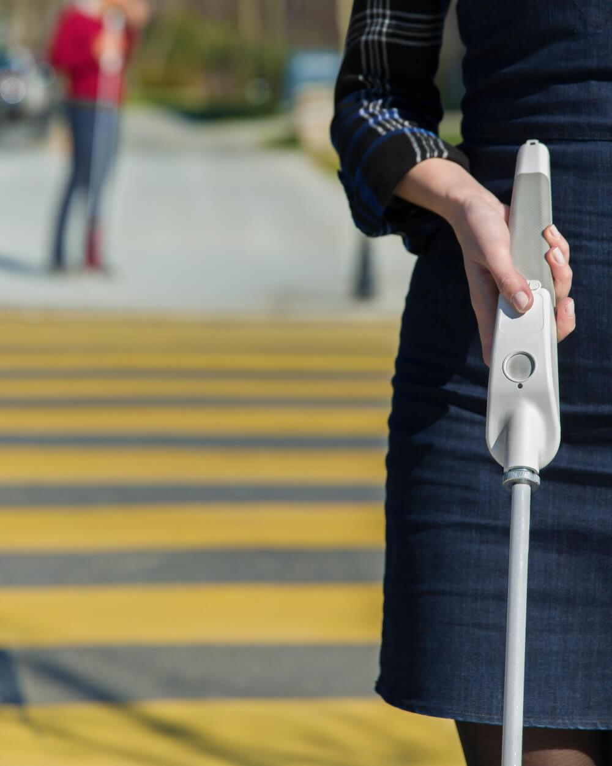
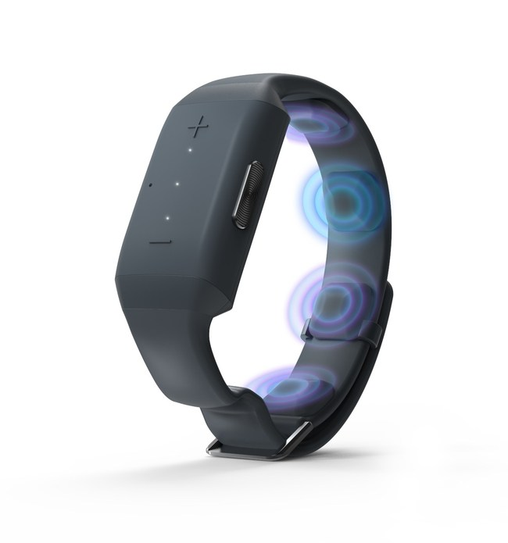
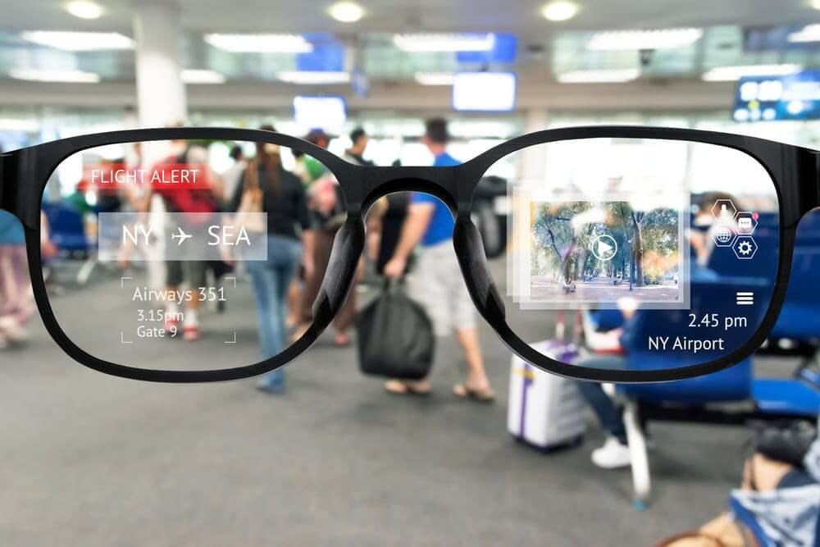
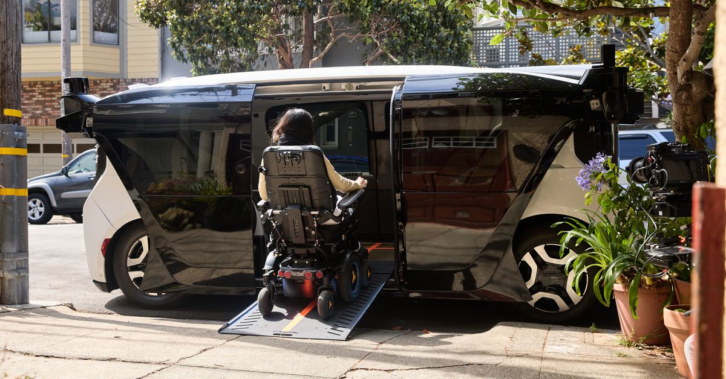
Introduction
Assistive Technology
Wristband
Smart glasses
Smart canes
Autonomous vehicles
Transport Disadvantaged
Disabled
Elderly
Non-drivers
Source: The Verge
Source: Medium
Source: TIGRIS
Source: Neosensory

Slide 5
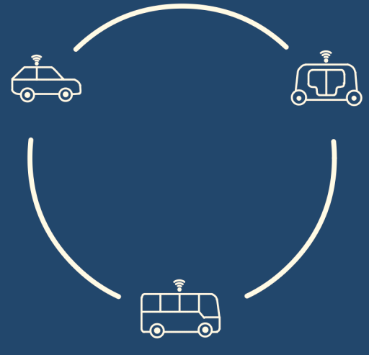
What are Autonomous Vehicles?
Autonomous vehicles
Capable of independently and self-sufficiently performing all driving functions in any environment
SAE Level 5
Integration into Transportation System
Private
Shared
Public transport
Private Autonomous Vehicles (PAVs)
Shared Autonomous Vehicles (SAVs)
Autonomous Public Transport (APT)

Slide 6
What is Transport-related Social Exclusion (TRSE)?
“The process by which individuals are prevented from participating in essential activities due to limited accessibility.” (Kenyon et al., 2003)
(Geurs & van Wee, 2004)

Slide 7
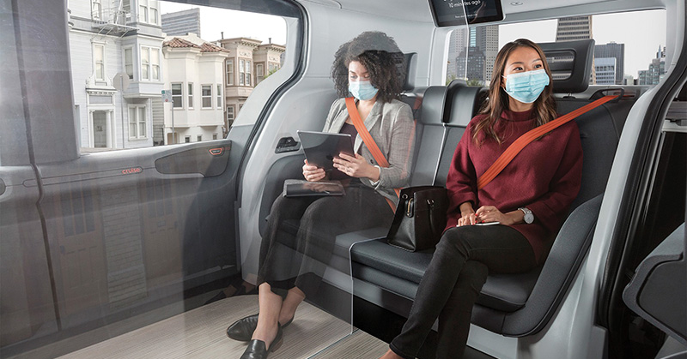
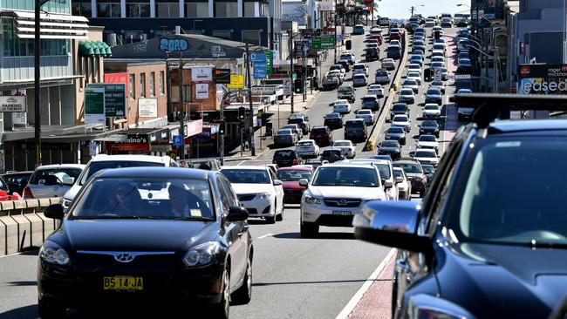
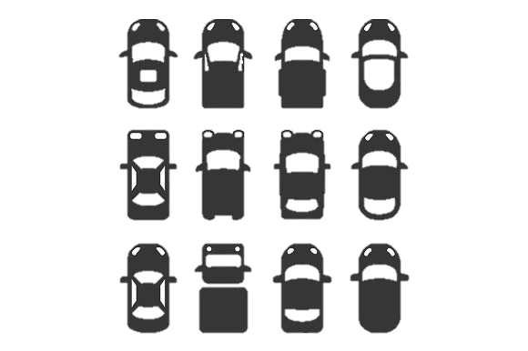

Impact of Autonomous Vehicles on Accessibility
Positive Impact on Accessibility
Improved mobility for certain transport-disadvantaged
Improved safety
Reduced travel costs
Opportunities to undertake non-driving activities
Enhanced network efficiency
Negative Impact on Accessibility
Increased demand
  Empty vehicles
  Increased demand due to reduction in travel resistance
Public transport cannibalization
$$$
$
Source: The Verge
Source: MEDIUM
Source: The Daily Telegraph

Slide 8

Problem
Less inclined toward new technology
Less affluent
Positive impact will mainly be accrued by AVs owners while negative impact are more pronounced on transport-disadvantaged individuals.
High risk of TRSE
Habitual travel choice
More inclusive future
Adequate infrastructure
Maximise AVs adoption among transport disadvantaged
Implication of AVs on accessibility
Positive Impact
Negative Impact
Positive Impact
Negative Impact
Possible Future

Slide 9
Aim and Objectives
Aim
To understand transport-disadvantaged individuals’ potential change in travel behaviour in the AV era as well as how those changes influence accessibility as a whole.
Objective 1
To explore the extent to which AVs influence travel and activity frequency among transport-disadvantaged people
Objective 2
To investigate the factors influencing mode choice of transport-disadvantaged people and their trade-off
Objective 3
To evaluate the change in accessibility for the general population under various AV deployment and policy scenarios
Study 1: Investigation of potential changes in travel and activity frequencies of transport-disadvantaged people
Study 2: Analysing Mode Choices of Transport-disadvantaged people
Study 3: Evaluation of Potential Impact of AVs on Accessibility and TRSE

Slide 10
Study 1
Investigation of potential changes in travel and activity frequencies of transport-disadvantaged people

Slide 11
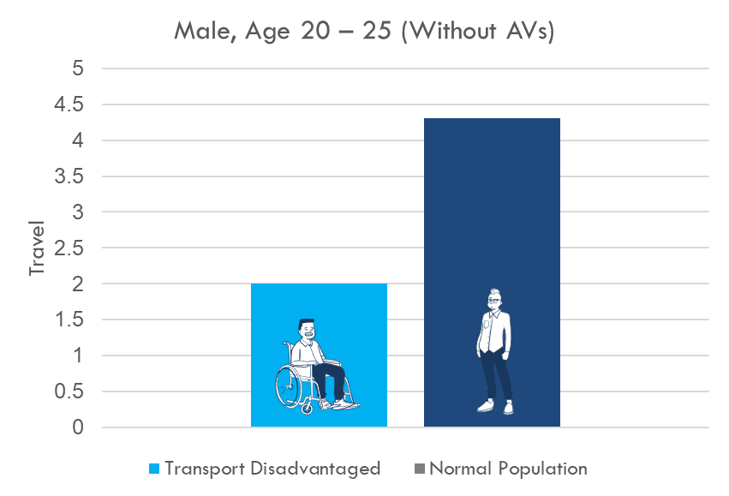
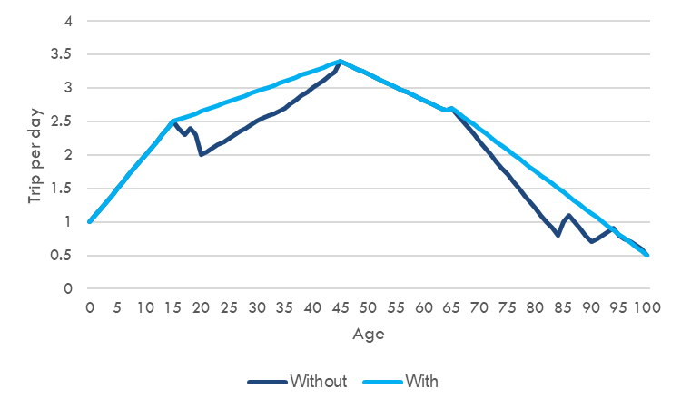
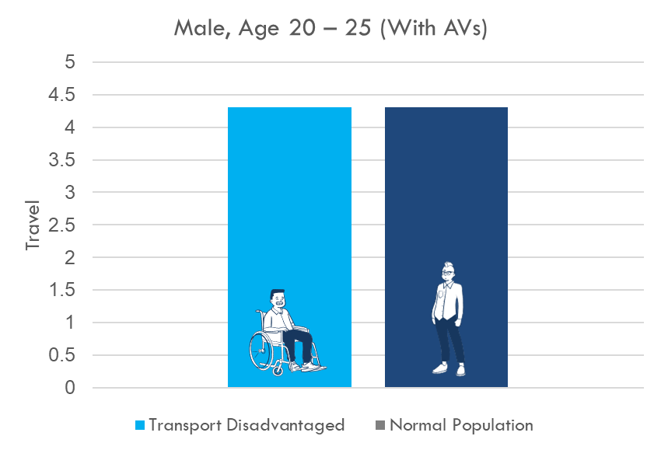
Literature Review : Investigation of potential changes in travel and activity frequencies of transport-disadvantaged people
Summary of Literature Review
14% increase in annual vehicle mile travel (Harper et al., 2016)
2 – 10% increase in overall vehicle travel (Wadud et al., 2016)
4.14 % increase in daily trips (Truong et al., 2017)
Research Gap
Handful of studies
Rely on strong assumptions
Need to control socio-economic factors such as income, work status, education levels, travel attitude
Increased in trip rate due to AVs

Slide 12
Methodology : Investigation of potential changes in travel and activity frequencies of transport-disadvantaged people
Quantitative Research
To quantify the extent to which AVs influence travel and activity frequency among transport-disadvantaged peoples
Data Collection: Sydney Household Travel Survey Data
Data Analysis: Propensity matching score
Qualitative Research
To explore perceptions of transport-disadvantaged individuals regarding AVs as a solution to their mobility barriers,
To prompt anticipated changes in their travel and activity pattern
Data Collection: Focus group
Data Analysis: Thematic analysis
Propensity matching score
Treatment Group
Controlled Group
Impact of Treatment on Trip and Activity Frequency
−
=

Slide 13
Study 2
Analysing Mode Choices of Transport-disadvantaged people

Slide 14
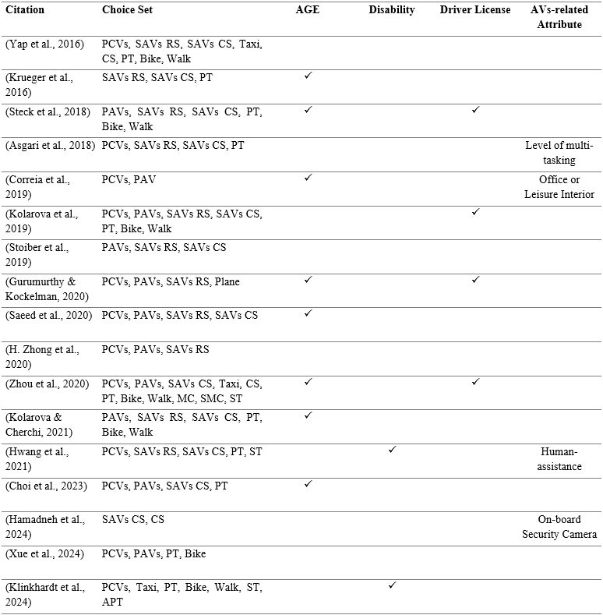
Literature Review : Analysing Mode Choices of Transport-disadvantaged people
Summary of Literature Review
Elderly people do not incline toward AVs
Preference of non-drivers are mixed.
Disabled people incline toward SAVs with rideshare and carshare.
Research Gaps
Limited research for disabled and non-drivers
Contradiction between expected and observed preference of elderly people on AVs
No information of how transport-disadvantaged people prioritise and trade-off among AVs attributes

Slide 15
Methodology : Analysing Mode Choices of Transport-disadvantaged people
Qualitative Research
To explore the attributes of AVs that hold significance for transport-disadvantaged individuals
Data Collection: Focus group
Data Analysis: Thematic analysis
Quantitative Research
To elucidate how transport-disadvantaged individual perceive the various attributes associated with AVs
To elicit willingness to pay for those attributes
Data Collection: Stated choice experiments
Data Analysis: Discrete choice analysis
Stated choice experiment (Example)
Attributes | Alternatives
 | Private autonomous vehicle | Shared autonomous vehicle | Autonomous public transport
Travel Time | Minutes | Minutes | Minutes
Travel Cost | $ | $ | $
Walk Time | Minutes | Minutes | Minutes
Wait Time | Minutes | Minutes | Minutes
Shared with Stranger | No | Yes | Yes
Accessibility Feature | Normal | Wheelchair ramp | Human assistance
Finding from focus group
Choice | O | O | O

Slide 16
Study 3
Evaluation of Potential Impact of AVs on Accessibility and TRSE

Slide 17
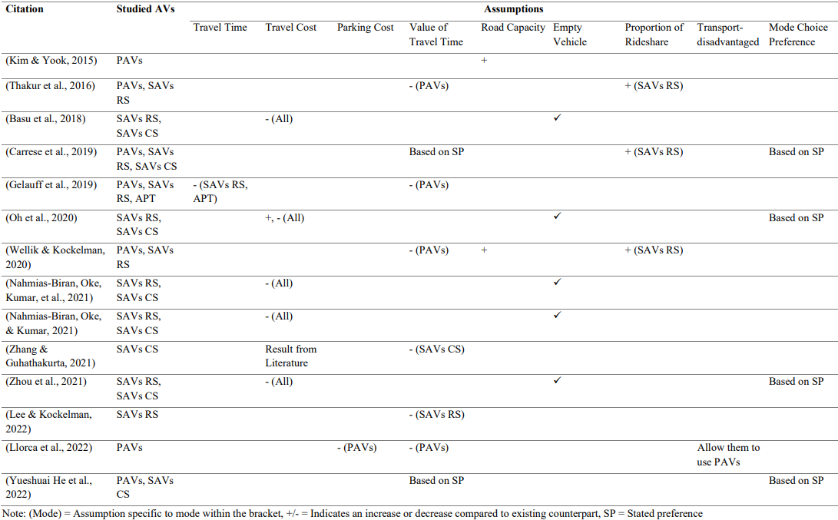
Literature Review : Evaluation of Potential Impact of AVs on Accessibility and Transport-related Social Exclusion (TRSE)
Modify existing Integrated land use and transport (ILUT) model
Assumptions
Reduction in value of travel time
Reduction in travel cost

Slide 18
Literature Review : Evaluation of Potential Impact of AVs on Accessibility and Transport-related Social Exclusion (TRSE)
Note: Red = PAVs specific assumption, Yellow = SAVs specific assumptions, Green = APT specific assumptions, Blue = General, Solid Arrow = Findings from literature, Dotted Arrow = Based on theory
Summary of Literature Review
Conflicting findings regarding impact of AVs on transport and land use
Conflicting implications for accessibility and TRSE
Research Gaps
Overlooked travel and activity changes among transport-disadvantaged individuals
No distinction in mode choice behaviour between transport-disadvantaged and general population

Slide 19
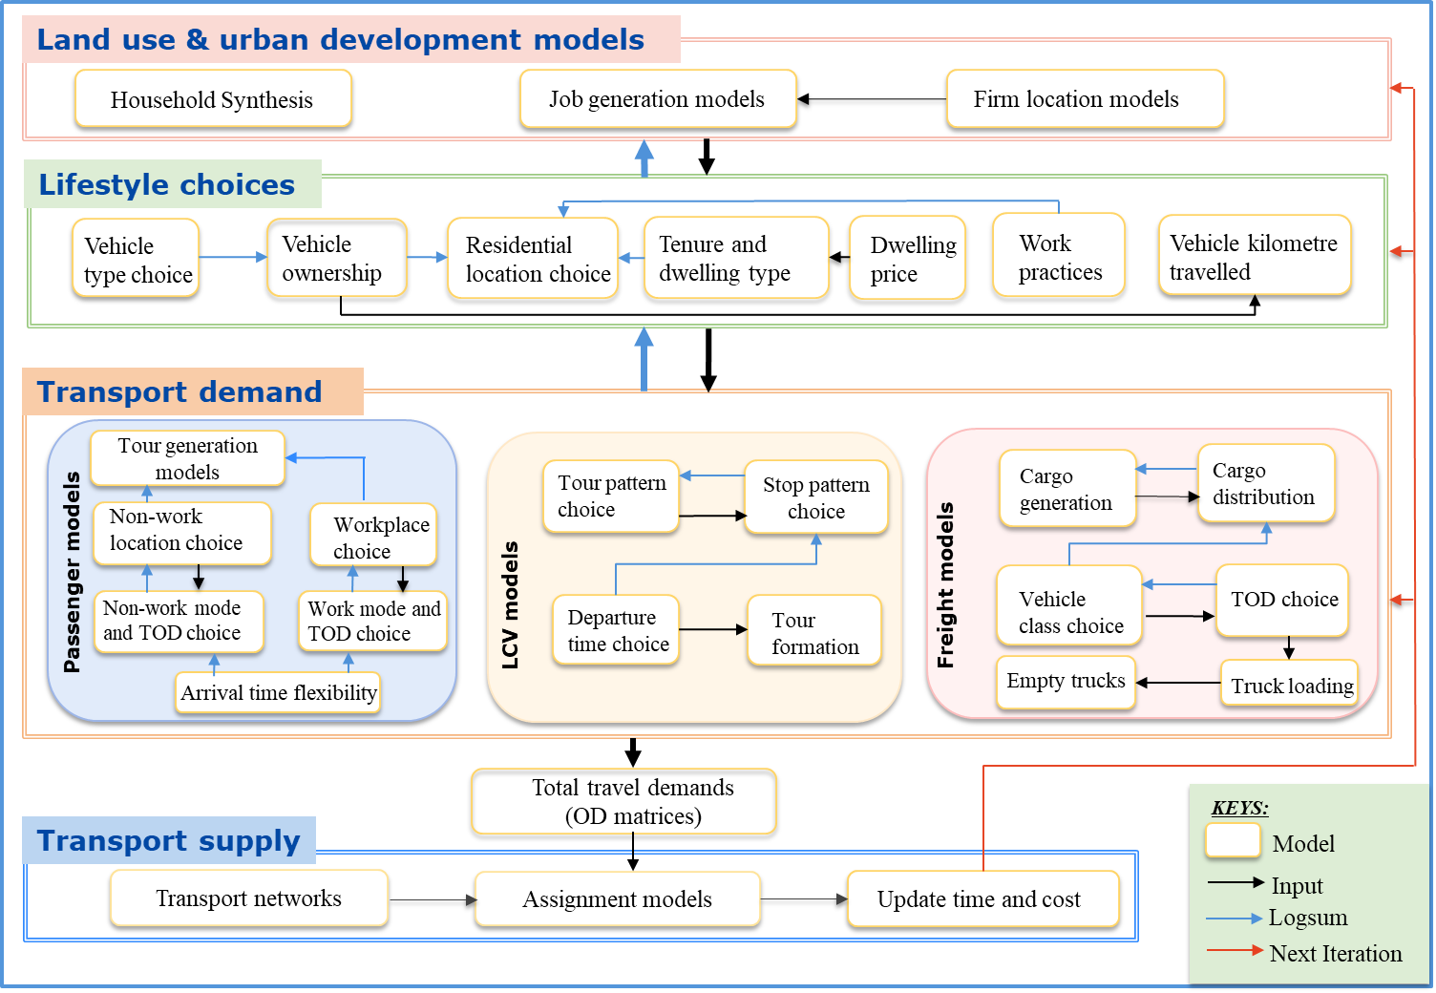
Methodology : Evaluation of Potential Impact of AVs on Accessibility and TRSE
Scenario Planning
MetroScan
Integrated land use and transport model
Travel demand & supply model
Land use model
Results
Base Scenario
Accessibility Base
Scenario 1
Accessibility S1
Scenario 2
Accessibility S2
…..
…..
Scenario N
Accessibility SN

Slide 20
Contributions
Study 1
Understanding of the potential changes in the travel and activity frequency of transport-disadvantaged people
Study 2
Understanding mode choice preferences of transport-disadvantaged people for AVs
Study 3
Understanding of how AVs may influence accessibility
Enable adequate infrastructure distribution and support system deployment
User-centred AVs design (physical and service)
Transport and land use policies aimed at mitigating TRSE
Social Inclusion

Slide 21
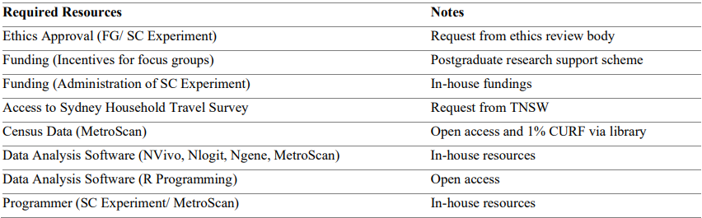

Resources

Slide 22
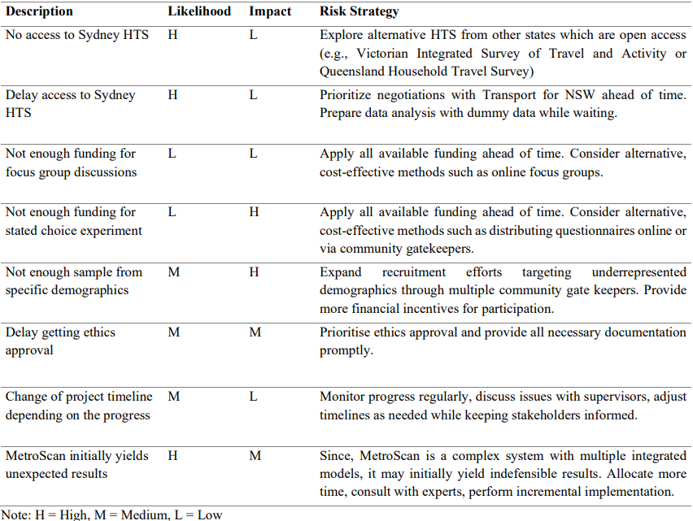
Risk Management

Slide 23
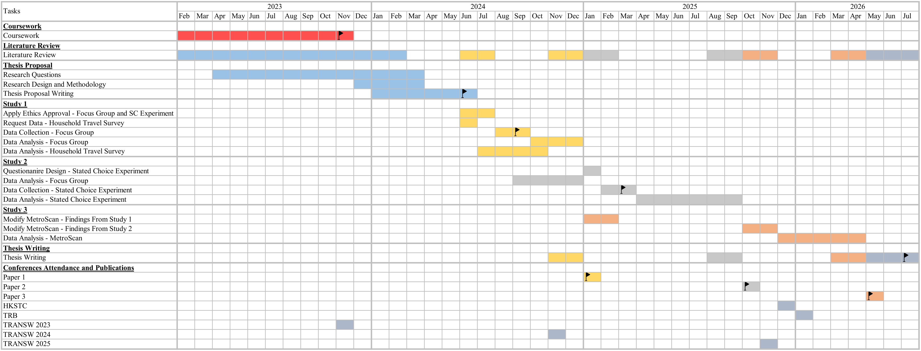
Timeline

Slide 24
Thank you for your time
Comments & Questions
Name: Arkar Than Win
Email: arkar.thanwin@sydney.edu.au

Slide 25
References
Asgari, H., Jin, X., & Corkery, T. (2018). A Stated Preference Survey Approach to Understanding Mobility Choices in Light of Shared Mobility Services and Automated Vehicle Technologies in the U.S. Transportation research record, 2672(47), 12-22. https://doi.org/10.1177/0361198118790124
Basu, R., Araldo, A., Akkinepally, A. P., Nahmias Biran, B. H., Basak, K., Seshadri, R., Deshmukh, N., Kumar, N., Azevedo, C. L., & Ben-Akiva, M. (2018). Automated Mobility-on-Demand vs. Mass Transit: A Multi-Modal Activity-Driven Agent-Based Simulation Approach. Transportation research record, 2672(8), 608-618. https://doi.org/10.1177/0361198118758630
Carrese, S., Nigro, M., Patella, S. M., & Toniolo, E. (2019). A preliminary study of the potential impact of autonomous vehicles on residential location in Rome. Research in transportation economics, 75, 55-61. https://doi.org/https://doi.org/10.1016/j.retrec.2019.02.005
Choi, S., Kim, D., Ko, J., Park, J., & Ko, Y. (2023). Value of travel time savings of autonomous vehicle commuters: a segmented valuation for local and inter-city travel. International Journal of Urban Sciences, 27(4), 645-669. https://doi.org/10.1080/12265934.2023.2165531
Correia, G. H. d. A., Looff, E., van Cranenburgh, S., Snelder, M., & van Arem, B. (2019). On the impact of vehicle automation on the value of travel time while performing work and leisure activities in a car: Theoretical insights and results from a stated preference survey. Transportation research. Part A, Policy and practice, 119, 359-382. https://doi.org/10.1016/j.tra.2018.11.016
Geurs, K. T., & van Wee, B. (2004). Accessibility evaluation of land-use and transport strategies: review and research directions. Journal of transport geography, 12(2), 127-140. https://doi.org/10.1016/j.jtrangeo.2003.10.005
Gurumurthy, K. M., & Kockelman, K. M. (2020). Modeling Americans’ autonomous vehicle preferences: A focus on dynamic ride-sharing, privacy & long-distance mode choices. Technological forecasting & social change, 150, 119792. https://doi.org/10.1016/j.techfore.2019.119792
Hamadneh, J., Hamdan, N., & Mahdi, A. (2024). Users’ Transport Mode Choices in the Autonomous Vehicle Age in Urban Areas. Journal of transportation engineering, Part A, 150(1). https://doi.org/10.1061/JTEPBS.TEENG-7961
Harper, C. D., Hendrickson, C. T., Mangones, S., & Samaras, C. (2016). Estimating potential increases in travel with autonomous vehicles for the non-driving, elderly and people with travel-restrictive medical conditions. Transportation research. Part C, Emerging technologies, 72, 1-9. https://doi.org/10.1016/j.trc.2016.09.003
Hwang, J., Li, W., Stough, L. M., Lee, C., & Turnbull, K. (2021). People with disabilities' perceptions of autonomous vehicles as a viable transportation option to improve mobility: an exploratory study using mixed methods. International journal of sustainable transportation, 15(12), 924-942. https://doi.org/10.1080/15568318.2020.1833115
Kenyon, S., Rafferty, J., & Lyons, G. (2003). Social exclusion and transport in the UK: a role for virtual accessibility in the alleviation of mobility-related social exclusion? Journal of social policy, 32(3), 317-338. https://doi.org/10.1017/S0047279403007037

Slide 26
References
Kim, K.-H., & Yook, D. (2015). An analysis of expected effects of the autonomous vehicles on transport and land use in Korea.
Klinkhardt, C., Kandler, K., Kostorz, N., Heilig, M., Kagerbauer, M., & Vortisch, P. (2024). Integrating Autonomous Busses as Door-to-Door and First-/Last-Mile Service into Public Transport: Findings from a Stated Choice Experiment. Transportation research record, 2678(2), 605-619. https://doi.org/10.1177/03611981231175900
Kolarova, V., & Cherchi, E. (2021). Impact of trust and travel experiences on the value of travel time savings for autonomous driving. Transportation Research Part C: Emerging Technologies, 131, 103354. https://doi.org/https://doi.org/10.1016/j.trc.2021.103354
Kolarova, V., Steck, F., & Bahamonde-Birke, F. J. (2019). Assessing the effect of autonomous driving on value of travel time savings: A comparison between current and future preferences. Transportation Research Part A: Policy and Practice, 129, 155-169. https://doi.org/https://doi.org/10.1016/j.tra.2019.08.011
Krueger, R., Rashidi, T. H., & Rose, J. M. (2016). Preferences for shared autonomous vehicles. Transportation research. Part C, Emerging technologies, 69, 343-355. https://doi.org/10.1016/j.trc.2016.06.015
Lee, J., & Kockelman, K. M. (2022). Access Benefits of Shared Autonomous Vehicle Fleets: Focus on Vulnerable Populations. Transportation research record, 2676(11), 568-582. https://doi.org/10.1177/03611981221094305
Llorca, C., Moreno, A., Ammar, G., & Moeckel, R. (2022). Impact of autonomous vehicles on household relocation: An agent-based simulation. Cities, 126, 103692. https://doi.org/https://doi.org/10.1016/j.cities.2022.103692
Nahmias-Biran, B.-h., Oke, J. B., & Kumar, N. (2021). Who benefits from AVs? Equity implications of automated vehicles policies in full-scale prototype cities. Transportation research. Part A, Policy and practice, 154, 92-107. https://doi.org/10.1016/j.tra.2021.09.013
Nahmias-Biran, B.-h., Oke, J. B., Kumar, N., Lima Azevedo, C., & Ben-Akiva, M. (2021). Evaluating the impacts of shared automated mobility on-demand services: an activity-based accessibility approach. Transportation (Dordrecht), 48(4), 1613-1638. https://doi.org/10.1007/s11116-020-10106-y
Oh, S., Seshadri, R., Azevedo, C. L., Kumar, N., Basak, K., & Ben-Akiva, M. (2020). Assessing the impacts of automated mobility-on-demand through agent-based simulation: A study of Singapore. Transportation Research Part A: Policy and Practice, 138, 367-388. https://doi.org/https://doi.org/10.1016/j.tra.2020.06.004
Saeed, T. U., Burris, M. W., Labi, S., & Sinha, K. C. (2020). An empirical discourse on forecasting the use of autonomous vehicles using consumers’ preferences. Technological Forecasting and Social Change, 158, 120130. https://doi.org/https://doi.org/10.1016/j.techfore.2020.120130

Slide 27
References
Steck, F., Kolarova, V., Bahamonde-Birke, F., Trommer, S., & Lenz, B. (2018). How Autonomous Driving May Affect the Value of Travel Time Savings for Commuting. Transportation research record, 2672(46), 11-20. https://doi.org/10.1177/0361198118757980
Stoiber, T., Schubert, I., Hoerler, R., & Burger, P. (2019). Will consumers prefer shared and pooled-use autonomous vehicles? A stated choice experiment with Swiss households. Transportation Research Part D: Transport and Environment, 71, 265-282. https://doi.org/https://doi.org/10.1016/j.trd.2018.12.019
Thakur, P., Kinghorn, R., & Grace, R. (2016). Urban form and function in the autonomus era. Australian Transport Research Forum,
Truong, L. T., De Gruyter, C., Currie, G., & Delbosc, A. (2017). Estimating the trip generation impacts of autonomous vehicles on car travel in Victoria, Australia. Transportation, 44(6), 1279-1292. https://doi.org/10.1007/s11116-017-9802-2
Wadud, Z., MacKenzie, D., & Leiby, P. (2016). Help or hindrance? The travel, energy and carbon impacts of highly automated vehicles. Transportation Research Part A: Policy and Practice, 86, 1-18. https://doi.org/https://doi.org/10.1016/j.tra.2015.12.001
Wellik, T., & Kockelman, K. (2020). Anticipating land-use impacts of self-driving vehicles in the Austin, Texas, region. Journal of transport and land use, 13(1), 185-205. https://doi.org/10.5198/jtlu.2020.1717
Xue, F., Yao, E., Cherchi, E., & Correia, G. H. d. A. (2024). Modeling the joint choice behavior of commuters’ travel mode and parking options for private autonomous vehicles. Transportation research. Part C, Emerging technologies, 159, 104471. https://doi.org/10.1016/j.trc.2023.104471
Yap, M. D., Correia, G., & van Arem, B. (2016). Preferences of travellers for using automated vehicles as last mile public transport of multimodal train trips. Transportation Research Part A: Policy and Practice, 94, 1-16. https://doi.org/https://doi.org/10.1016/j.tra.2016.09.003
Yueshuai He, B., Jiang, Q., & Ma, J. (2022). Connected automated vehicle impacts in Southern California part-I: Travel behavior and demand analysis. Transportation research. Part D, Transport and environment, 109, 103329. https://doi.org/10.1016/j.trd.2022.103329
Zhang, W., & Guhathakurta, S. (2021). Residential Location Choice in the Era of Shared Autonomous Vehicles. Journal of planning education and research, 41(2), 135-148. https://doi.org/10.1177/0739456X18776062
Zhong, H., Li, W., Burris, M. W., Talebpour, A., & Sinha, K. C. (2020). Will autonomous vehicles change auto commuters’ value of travel time? Transportation Research Part D: Transport and Environment, 83, 102303. https://doi.org/https://doi.org/10.1016/j.trd.2020.102303

Slide 28
References
Zhou, F., Zheng, Z., Whitehead, J., Washington, S., Perrons, R. K., & Page, L. (2020). Preference heterogeneity in mode choice for car-sharing and shared automated vehicles. Transportation research. Part A, Policy and practice, 132, 633-650. https://doi.org/10.1016/j.tra.2019.12.004
Zhou, M., Le, D.-T., Nguyen-Phuoc, D. Q., Zegras, P. C., & Ferreira, J. (2021). Simulating impacts of Automated Mobility-on-Demand on accessibility and residential relocation. Cities, 118, 103345. https://doi.org/10.1016/j.cities.2021.103345

